Slide 1
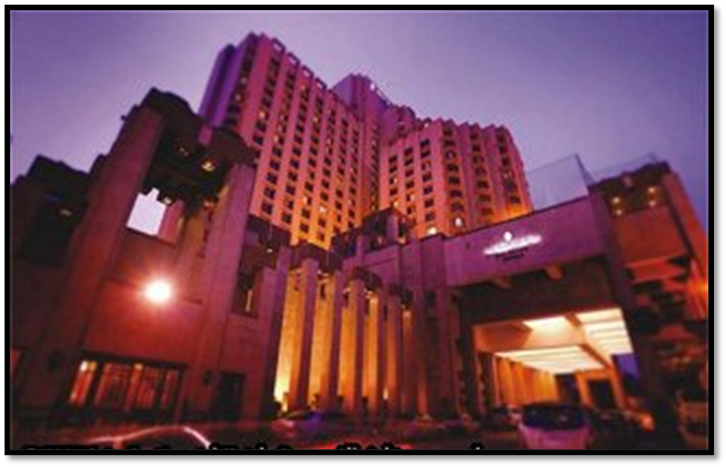
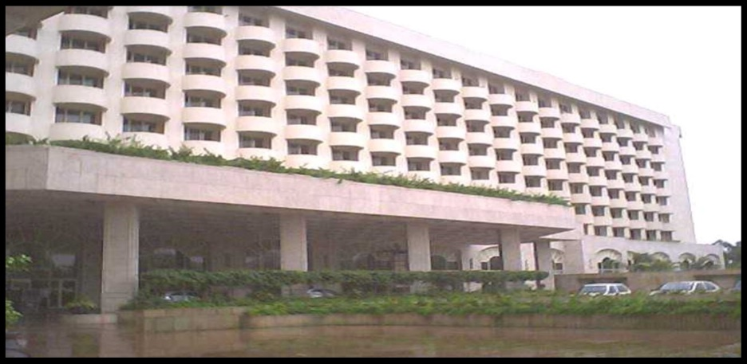
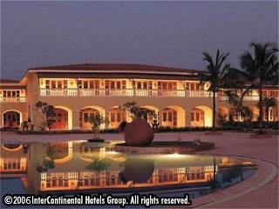
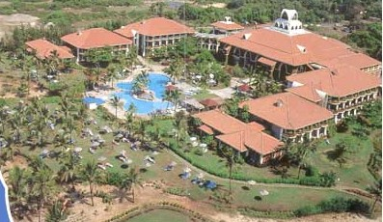
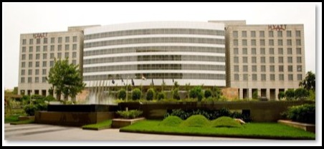
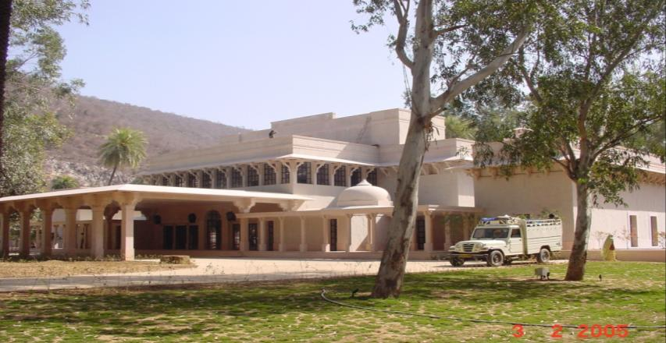
ANNEXURE II
Transwat Techno-Engineering Services Ltd
[ Formerly Wadia Techno-Engineering Ltd ]
(Est. in 1960)
(HOSPITALITY SECTOR PROFILE)
Design / Project Management Consultants for Highways, Bridges, Elevated Roads - Buildings (Commercial, Industrial, Institutional Buildings etc;)
- Major Irrigation (Reservoirs, Dams, Tunnels, Lift Irrigation, Canals) - Smart Cities - Water Supply - Industrial Parks - Logistic Parks
Regd. Office:
A-201, Upsahra lane, Shree Arham Bluz, C D Barfiwala Cross Lane, Andheri (W) , Mumbai - 400058.
Tel : 022- 44545653; 98858 09317 Email : bd@transwat.com ; www.transwat.com

Slide 2

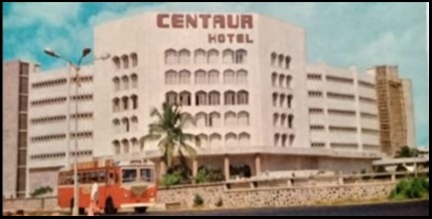
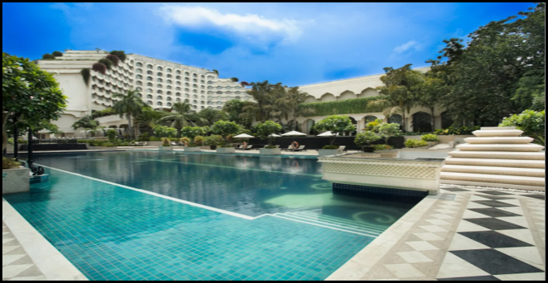
Our PMC Services
📊Pre-Construction Advisory
Market assessment and feasibility studies
Site selection and land due diligence
Concept development and master planning support
Assistance with statutory approvals and permits
📐Design & Engineering Management
Coordination with architects and MEP consultants
Design reviews for cost-efficiency and functionality
BIM integration and sustainable design support
Value engineering and technical vetting
🏗️ Project Management & Monitoring with OSHA Compliance
Development of detailed project schedules (WBS, CPM, PERT)
Support in BOQ validation, tendering, and vendor selection
Oversight of QA/QC processes, Cost Control & Safety Management
🏁 Post-Construction & Handover
Coordination of final testing and commissioning
Closure of snag lists and contractor bill verifications
Preparation of as-built drawings and HOTO documentation
OEM User Manual Training
Transwat Techno-Engineering Services Ltd

Slide 3
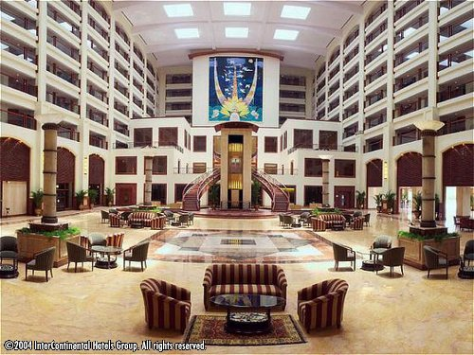
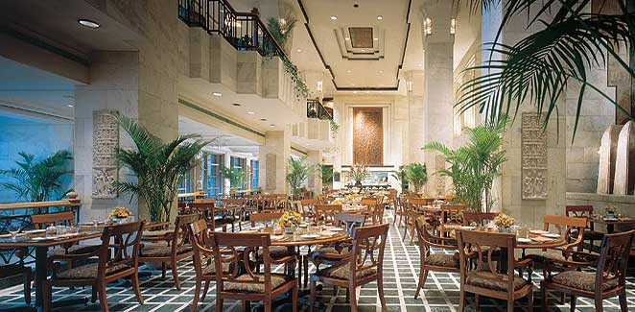
Methodology
📊 Pre-Construction Phase
Define project scope and user requirements
Conduct techno-commercial feasibility studies
Develop execution strategy and milestone-based schedule
Plan procurement and authority approvals
📐 Design Development
Finalize design briefs with stakeholders
Coordinate across architectural, structural, and MEP teams
Ensure constructability and value optimization
Identify and track clearance requirements
🏗️ Construction Stage
Plan site mobilization and resources
Conduct daily and weekly progress tracking
Supervise vendors and resolve site-level issues
Manage cost flow and certification
Transwat Techno-Engineering Services Ltd

Slide 4

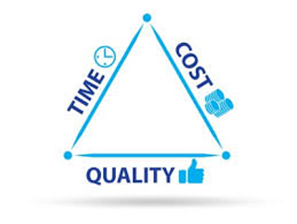
Key Advantages
🌟 Sector-Specific Expertise
Deep understanding of hospitality & entertainment project dynamics
Proven experience across luxury hotels, resorts, multiplexes, and leisure zones
📈 Time Optimization & Cost Control
Realistic planning, fast-track execution, and cost-saving interventions
Minimized delays through proactive monitoring and agile adjustments
🧩 Seamless Coordination
One-stop interface for client, architect, contractors & vendors
Effective management of multi-stakeholder inputs and approvals
🛡️ Quality Assurance & Risk Mitigation
Robust QA/QC protocols and periodic audits
Early detection of risks and structured mitigation strategies
🔍 Transparent Reporting & Control
Real-time dashboards, MIS reports & escalation protocols
Full visibility into progress, bottlenecks, costs & timelines
🚀 Operational Readiness Support
Handover, licensing, pre-opening coordination, and facility readiness
Support in branding, interiors, and guest experience enhancement
Transwat Techno-Engineering Services Ltd

Slide 5
Key Hotel Projects
Transwat Techno-Engineering Services Ltd

Slide 6
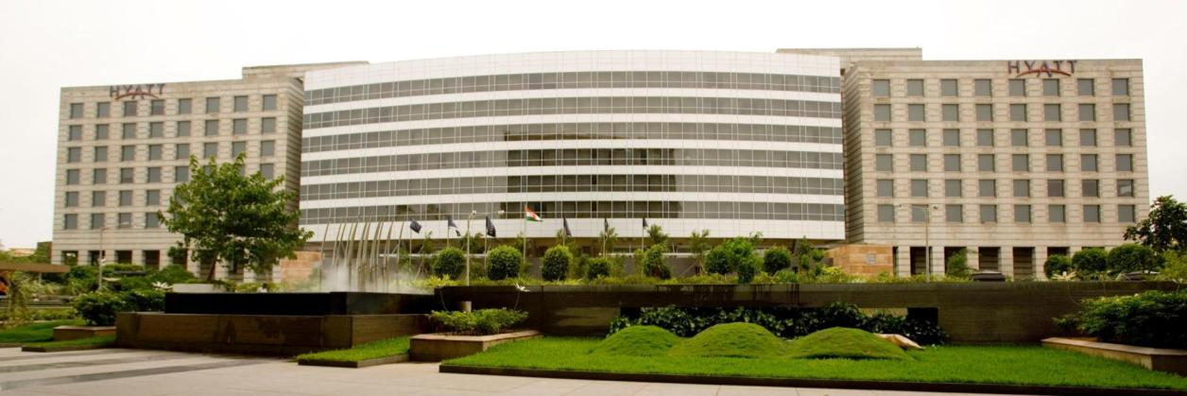
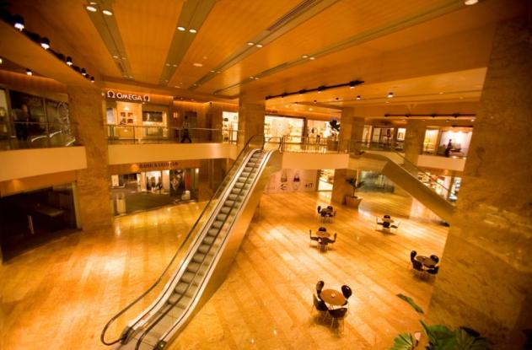
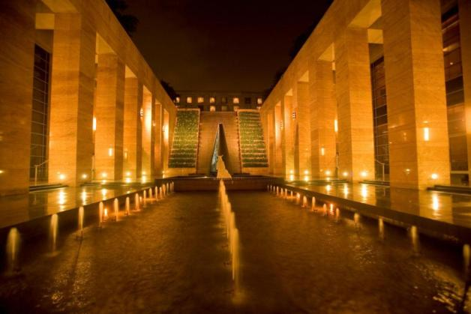
Building Project – Grand Hyatt – Five Star Deluxe Hotel (Mumbai)
Client Name: Seajuli Property and Viniyog Limited
SBUA: 1,10,000 sq.m.
Project Cost: INR 620 Crores
Completion Year: 2003
Services Provided:
Architectural (Post Design Development) & Structural Designing
Proof Checking of HVAC, Electrical, Lift, IBMS, Security System, Fire Alarm, Audio-Visual & Telephone, Designing of Plumbing, Fire Fighting, Natural Gas Installation, Boilers, WTP, STP
Key Features:
651 Guest-Rooms & 95 Service suites
100,000 sq.ft. (9,290 m2) for Retail
Food court , Regency club with Board rooms, Health spa, Fitness center, Business Centre and Pool
Grand Ballroom (900 seats)
Bar/Coffee shop (160 seats), Café / Brasserie (100 seats)
Parking for 780 cars (31,500 m2)
Transwat Techno-Engineering Services Ltd

Slide 7
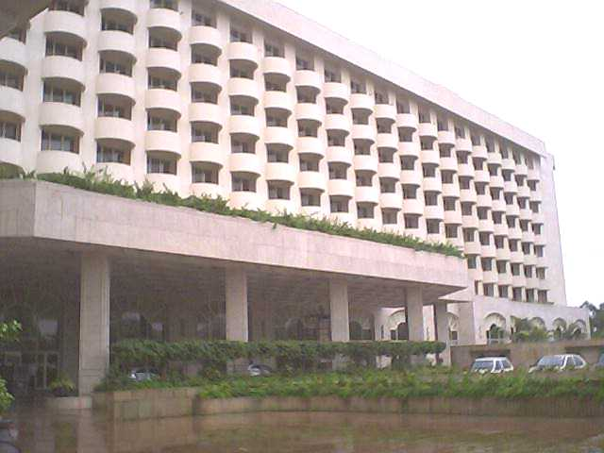
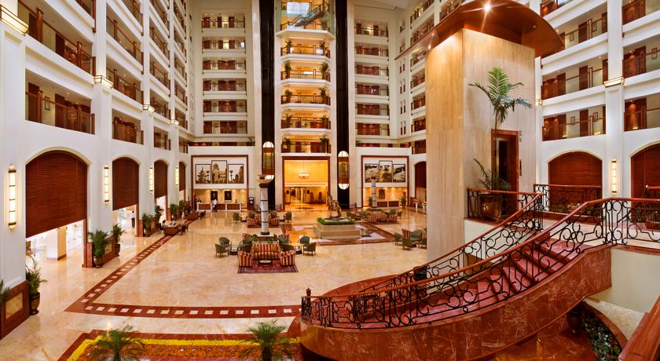
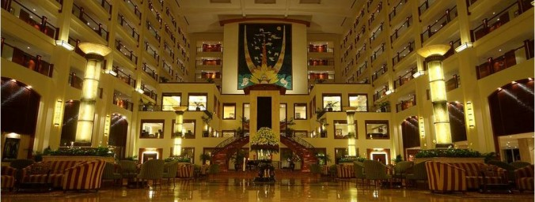
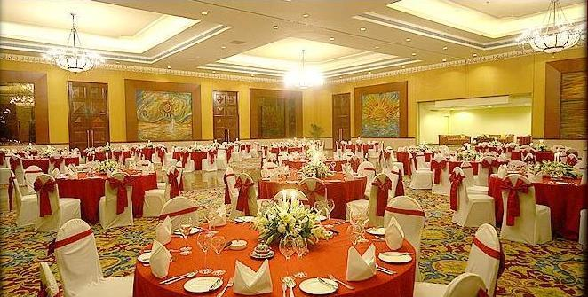
Hotel Grand Inter-Continental (Mumbai)
Client Name: Bharat Hotels Limited
SBUA: 70, 740 m²
Project Cost: Rs. 170.00 Crores (excluding Land cost)
Completion Year: March 2003
Services Provided:
Project Management including Construction Management
Key Features:
5 Star deluxe Hotel comprising Hotel Block (double basement + 11 Floors) & Commercial Block (double basement + 9 Floors). Hotel Block (61, 825 Sqm) consists of suites 31 Nos. and guestrooms 340 Nos.
Commercial Block consist of 21 Apartments (2100 sqm).
Other Facilities include Grand Ball room, Banquet Hall, Pub, Restaurants, Swimming Pool, Heath Club, and Shopping & Casino.
Transwat Techno-Engineering Services Ltd

Slide 8
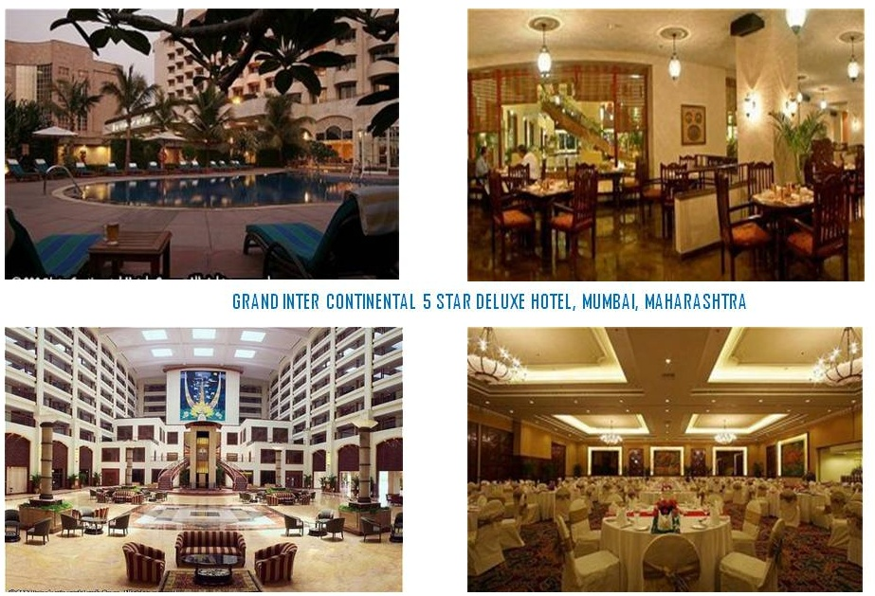
Hotel Grand Inter-Continental (Mumbai)
Transwat Techno-Engineering Services Ltd

Slide 9
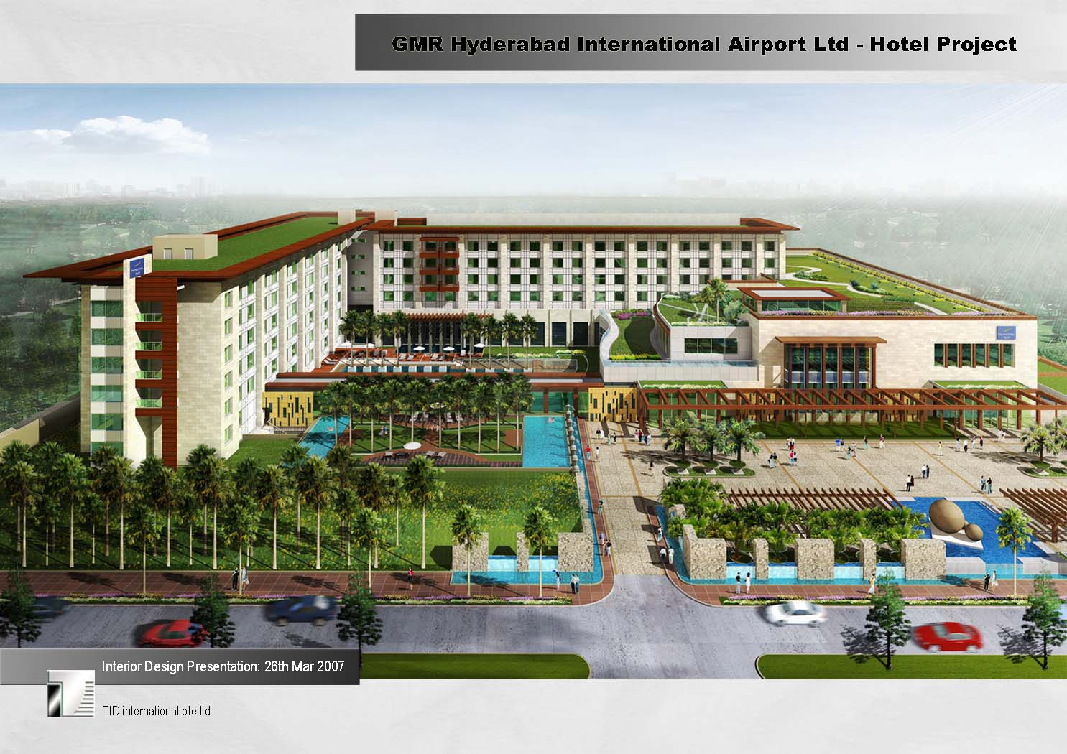
Novotel, Shamshabad (Hyderabad)
Transwat Techno-Engineering Services Ltd

Slide 10
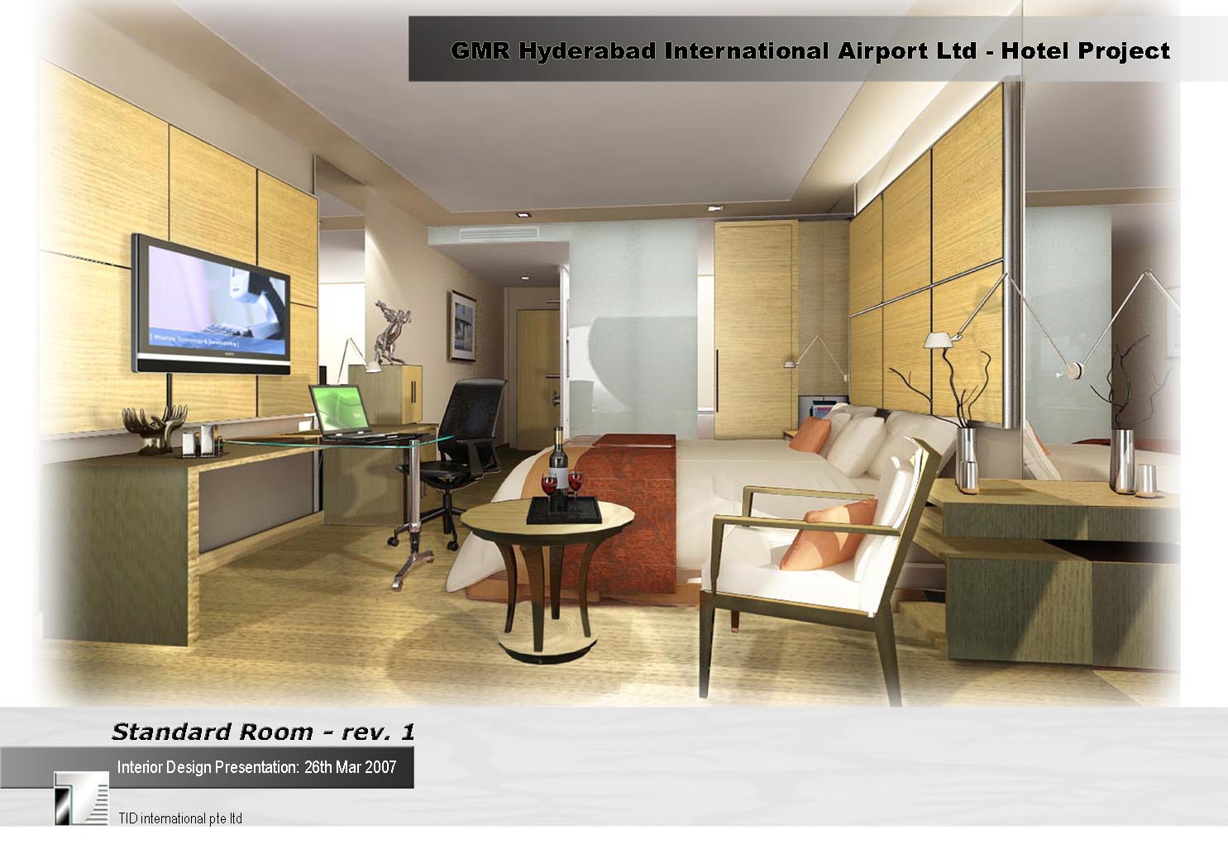
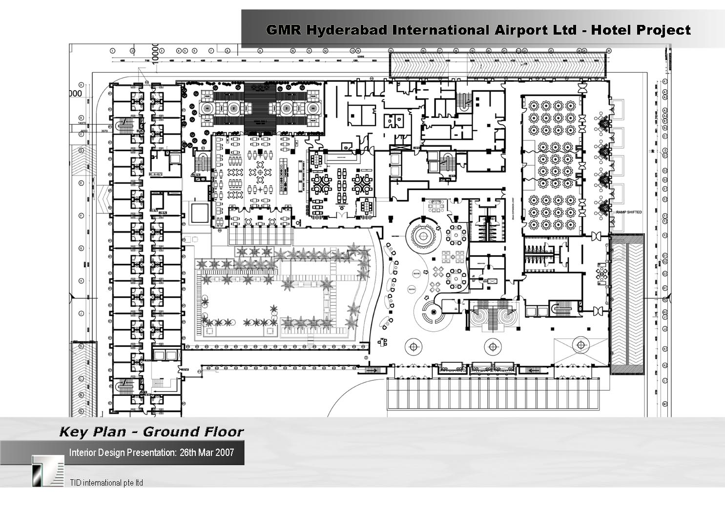
Novotel, Shamshabad Hyderabad
Project Associates
Owner : GMR Hyderabad Air Ports Ltd., Hyderabad
Operator : Novotel
PMC : Wadia Techno Engineering Services
Ltd.(GEL).Mumbai
Project Synopsis
Site Area : 4.08 Acres
Built up area : 1.90,000 Sq. Ft.
No. Floors : Cellar+ Stilt+ Ground + 6 Floors
Standard Rooms : 308 Rooms(320 Sq. ft. Each)
Executive Suites : 6 No.s (640 Sq. Ft. Each)
Junior Suites : 6 No.s (500 Sq. Ft. Each)
Executive Lounge :1500 Sq. Ft.
Screw Lounge :1000 Sq. Ft.
Banquet Halls : 3 No.s(15000 Sq. Ft. Each)
Meeting Halls/BC : 2 No.s. 600 Sq. Ft.
GM Apartments : 1500 Sq.Ft.
Bar And Restaurant: 8000 Sq. Ft
Handy Capped Room: 320 Sq. Ft.
Swimming Pool : 30,000 Sq. Ft.
Parking Capacity : 600 Cars including Limousine Parking
Transwat Techno-Engineering Services Ltd

Slide 11
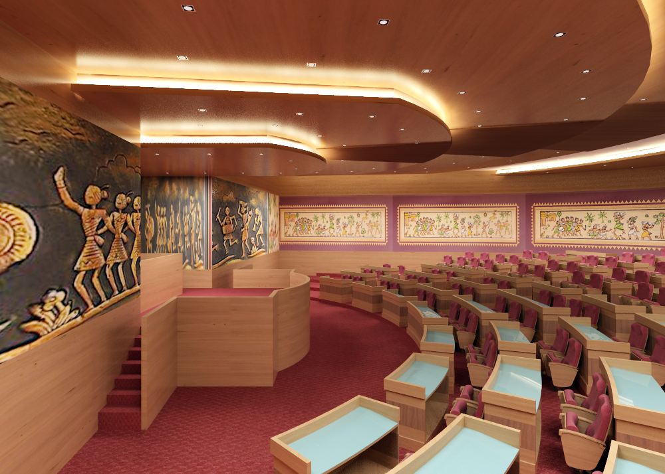
CONCEPT INTERIOR RENOVATION
Transwat Techno-Engineering Services Ltd

Slide 12
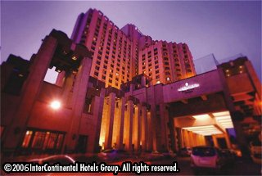
Consultancy Services – Hotels and Resorts
Intercontinental The Grand, New Delhi
Intercontinental, The Grand Beach Resort Goa
Renaissance Resort, Goa
Hyatt Regency, New Delhi
Intercontinental The Grand, Mumbai
Aman Bagh Resort Hotel, Rajasthan
Wadia Techno-Engineering Services Ltd
Transwat Techno-Engineering Services Ltd

Slide 13
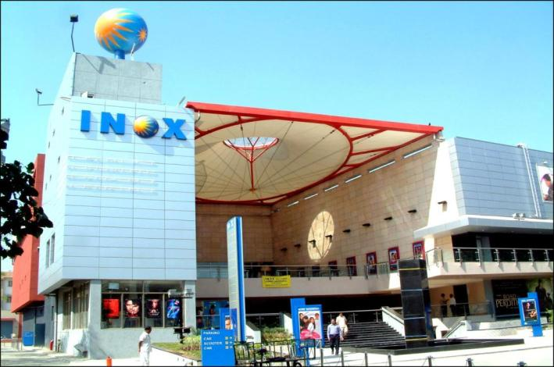
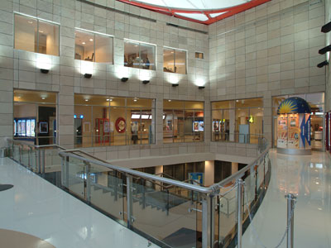
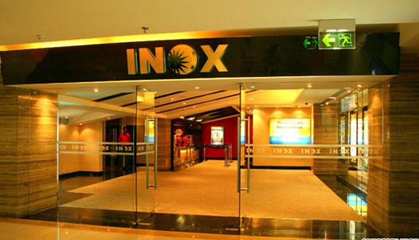
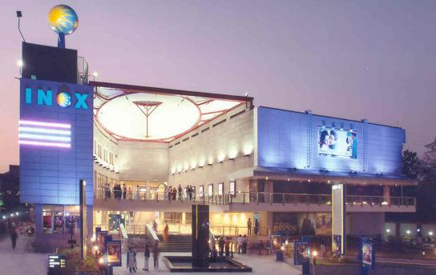
INOX Multiplex Theatre
Client Name:
INOX Leisure Ltd
SBUA:
7000 sq.m.
Project Cost:
INR 25 Crores
Completion Year:
2004
Services Provided:
Detailed Architecture Designing & Planning
Utility and electrical designing including HVAC
Interior Design & Engineering
Seeking approvals from authorities
Key Features:
4 Screens, 1,356 Seats
Cinema : 2,293 m2
Retail :3,987 m2
Other Areas: 1,120 m2
Facilities are provided for Leisure, Entertainment
Recreation, Eating and Retail
Transwat Techno-Engineering Services Ltd

Slide 14
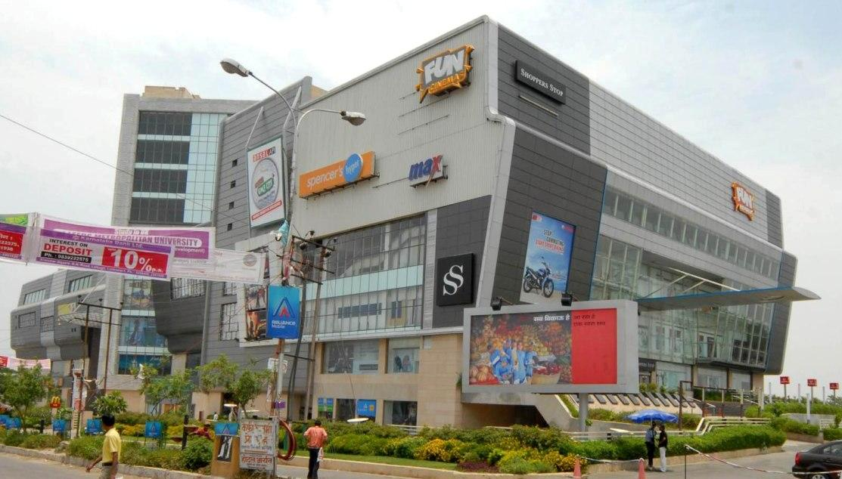
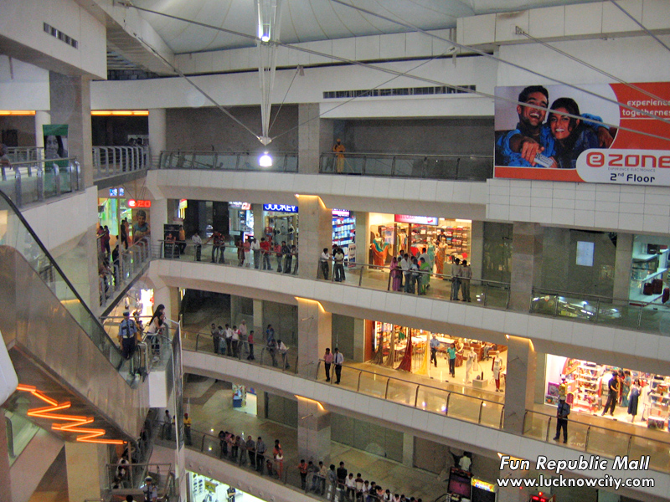
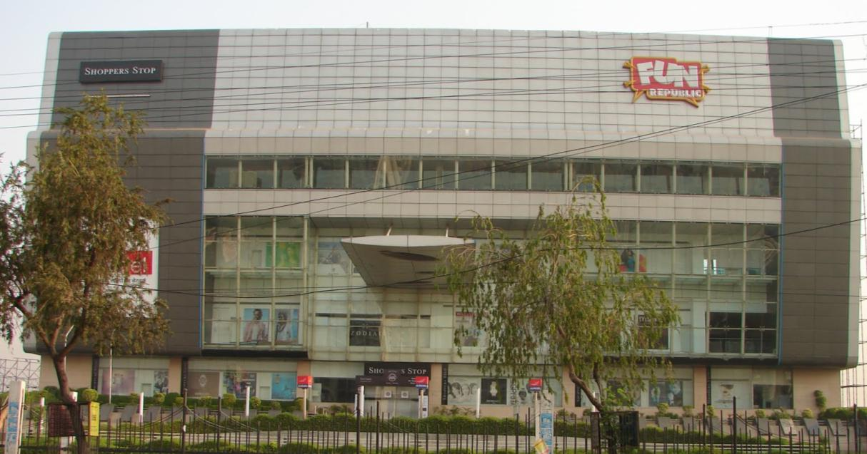
Fun Republic and Shopping Mall Lucknow, Uttar Pradesh
Client Name:
E-City Entertainment Pvt. Ltd.
SBUA:
53,000 sq.m.
Project Cost:
INR 60 Crores
Completion Year:
2006
Services Provided:
Project Management Consultancy
Design & engineering of utilities
Proof checking of various systems
Key Features:
4 Screens
1,425 Seats
Cinema Hall : 2,950 m2
Hotel : 2900 m2
Restaurants: 1,250 m2
Retail : 8,100 m2
Basement Area :13,500 m2
Facilities are provided for Leisure, Entertainment
Recreation, Eating and Retail
Transwat Techno-Engineering Services Ltd

Slide 15








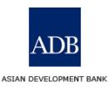

























Key Clients
Key Clients
Transwat Techno-Engineering Services Ltd

Slide 16
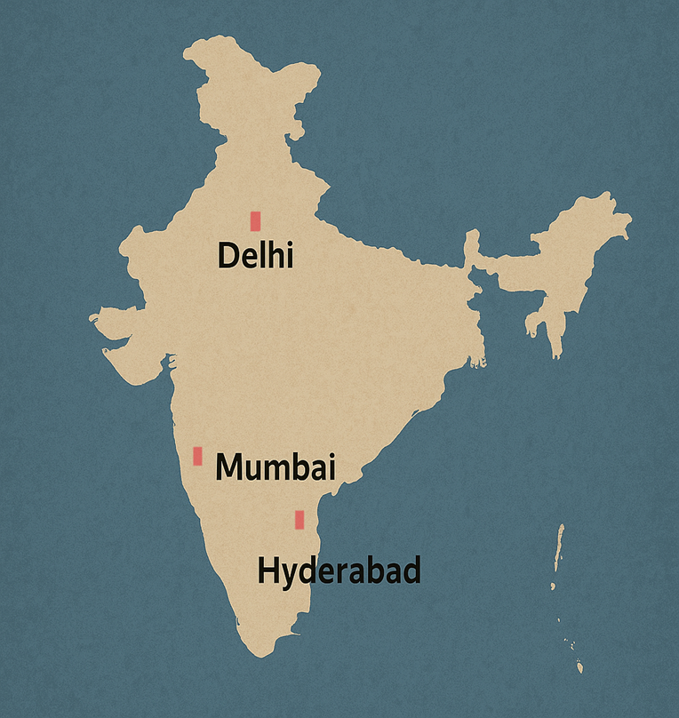
FOR ENQUIRIES, PLEASE CONTACT
M Sridhar Reddy : +91 98858 09317 (Director)
Email : reddy@transwat.com
H Charles Sunny : + 91 9000 347 257 (Business Head)
Email: bd@transwat.com
TRANSWAT TECHNO-ENGINEERING SERVICES LTD
(Formerly WADIA TECHNO-ENGINEERING SERVICES LTD)
Regd. Office:
A-201, Upsahra lane, Shree Arham Bluz, C D Barfiwala Cross Lane, Andheri (W) , Mumbai - 400058.
Tel : 022- 44545653; 98858 09317 Email : bd@transwat.com ; www.transwat.com
Corp. Office:
# 8-2-686/K/1&2, C-3, 2nd Floor, ‘Kimtee Square’, Road No: 12,
Banjara Hills, Hyderabad – 500 034
Phone : +91 40 23320233; +91 98854 74414;
Email : bd@transwat.com ; reddy@transwat.com
Regional Office:
House no. 226 , Block No 3, Subhash Nagar,
New Delhi 110027Mobile : +91 – 91121 48400 / +91- 9885 74414
Transwat Techno-Engineering Services Ltd

